Slide 1
The Dehydration of Food
Chapter 26
Eric Chase
Jen Hoffman
Nicole Herdzik

Slide 2
Objectives
Vocabulary
List benefits of dehydrated foods
Describe the role of air temperature and circulation in dehydration
Compare different methods of dehydration
Explain how pretreating foods improves dehydration
Demonstrate how to store dried foods
Compare different methods of rehydrating foods
Caseharden
Dehydrator
Dehydrofreezing
Rehydration
Steam blanching
Sulfiting
Sulfuring
Syrup blanching

Slide 3
Benefits of Dehydration
Longer storage
Drying foods preserves food without for longer storage
Smaller size and weight
Drying decreases weight and bulk
Convenience
Time savers
Can be prepared in a fraction

Slide 4
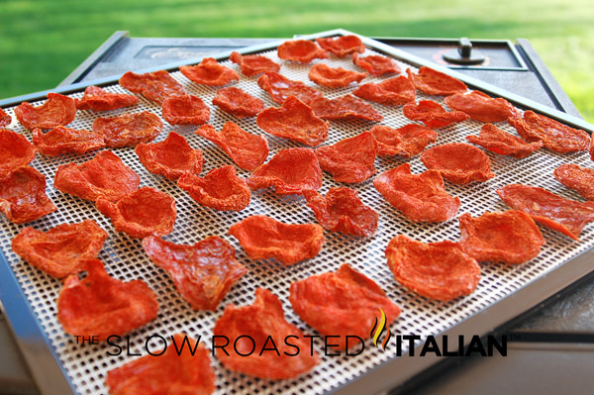
Dehydration in History
Sun drying is the oldest method of dehydration
the first mechanical food drying was in 1795
Large scale dehydration began to preserve food for armies in World War I
Typical home methods
The oven
The sun
Special dehydration appliance

Slide 5
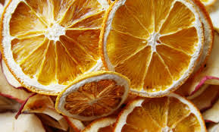
Principles of dehydration
Temperature and air must be monitored to avoid bacteria growth & spoilage
If food is dried too slowly, bacteria have time to multiply and cause spoilage
Temperatures too high = caseharden
Cook the outside of food and food forms hard outer layer trapping moisture

Slide 6
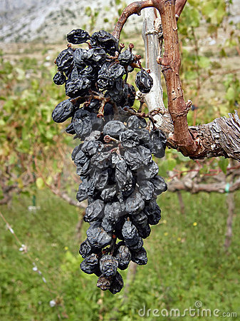
Preparation of dehydration
Most foods are sliced into thin pieces to speed the drying process
Fruits that are dried whole such as grapes, are poked with holes to allow moisture to escape
Sulfiting, sulfuring, blanching

Slide 7
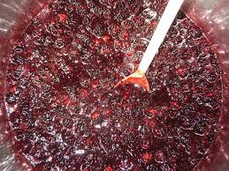
Pretreatment
When food is soaked in a solution of water and sodium metabisulfite or sodium bisulfide = sulfiting
Maximum of 30 minutes to soak or food can become mushy
Disadvantage is extends drying times 15-20% due to water the food absorbs

Slide 8
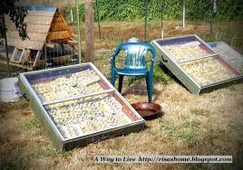
Pretreatment
Food placed on large trays that are stacked together and covered; burning sulfur that contain sulfur dioxide gas = sulfuring
Method used by most commercial fruit dryers
Takes 1-4 hours; food is dried outdoors either by sunlight or in a dryer to help decrease fumes
Food maintains original shape and color

Slide 9
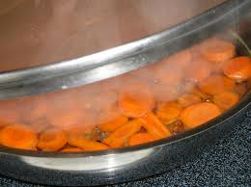
Pretreatment
Food placed in a perforated basket over boiling water and blanched by steam = steam blanching
Shortens the time needed for drying by relaxing the tissue walls for moisture to escape
Less water is added to food, drying time is shorter and vitamins and minerals are lost
Commonly used for vegetables
Cut fruit soaked in hot solution of sugar, corn syrup, water and then dried = syrup blanching

Slide 10
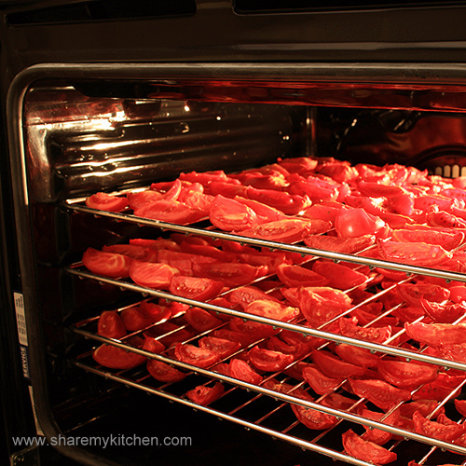
Methods of Dehydration
Sun drying is an effective way of dehydration
Room drying is another way to
dehydrate foods
Oven drying is also an option
Dehydrators are a relatively new invention that is now the safest and most effective

Slide 11
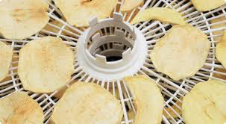
Methods of Dehydration
Dehydrofreezing is a method used by food processing industries.
It is a combination of partial drying and freezing
Food has the same moisture content, but does not mold

Slide 12
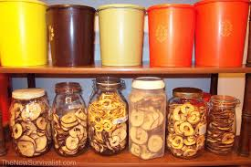
Storing Dried Foods
Stored foods must have the right moisture content
Food must be contained in jars, heavy plastic bags, or cans
Best stored at room temperature
Dried food needs to be checked periodically for mold

Slide 13
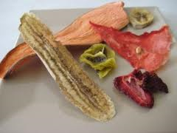
Rehydration
Rehydration is replacing water that was previously removed
Also called reconstitution
Bring water to a boil, then remove the water from the head and place dried fruit inside for five to ten minutes
Place fruit in a steamer over boiling water for three to fie minutes

Slide 14
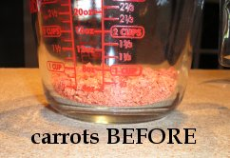
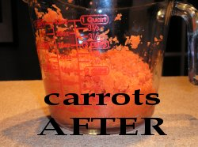
Rehydration
Vegetables take longer than fruit
Soaking times vary with each vegetable

Slide 15
video
http://video.about.com/foodpreservation/How-to-Dehydrate-Food.htm

